Slide 1


Data Analysis of Ride Fare Dataset
Understanding the factors influencing fare amount

Slide 2
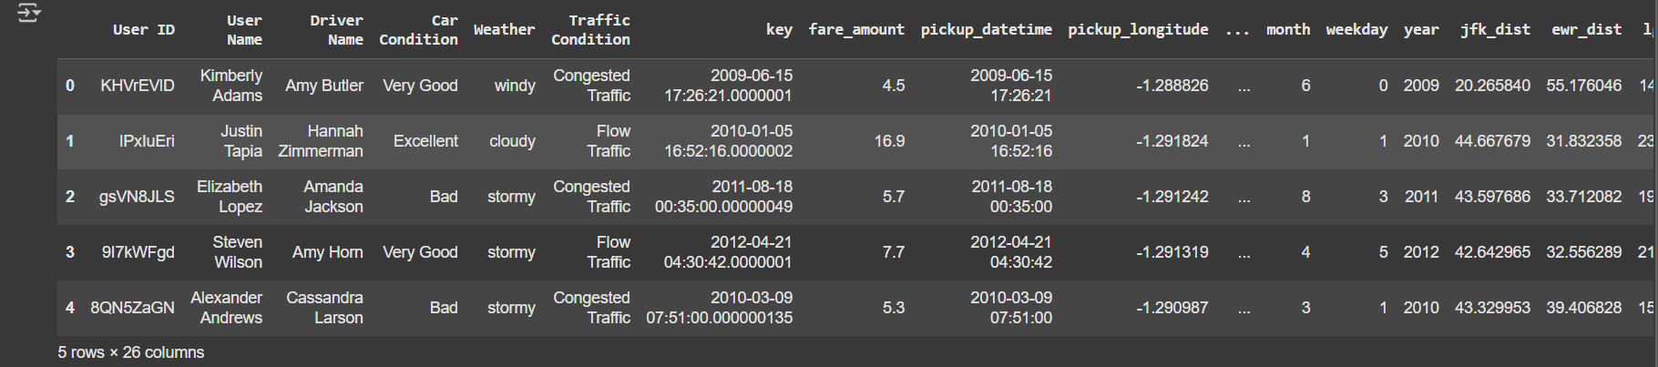
Dataset Overview
Key Features:
Fare Amount
Distance
Passenger Count
Car Condition
Weather
Traffic Condition
Pickup/Drop-off Date time and Locations
Noted Issues:
Some missing values in location/distance columns
Presence of negative fare values

Slide 3
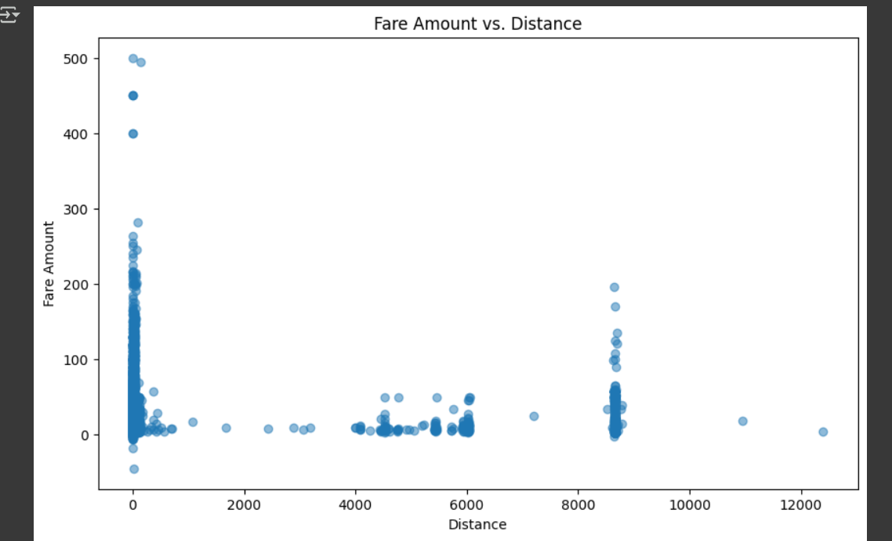
Fare Amount vs. Distance
Strong positive correlation: Longer trips = higher fares.
Short trips (under 2K units) cluster at low fares, while long trips (10K+) show high variability (possibly due to tolls, routes, or dynamic pricing).

Slide 4
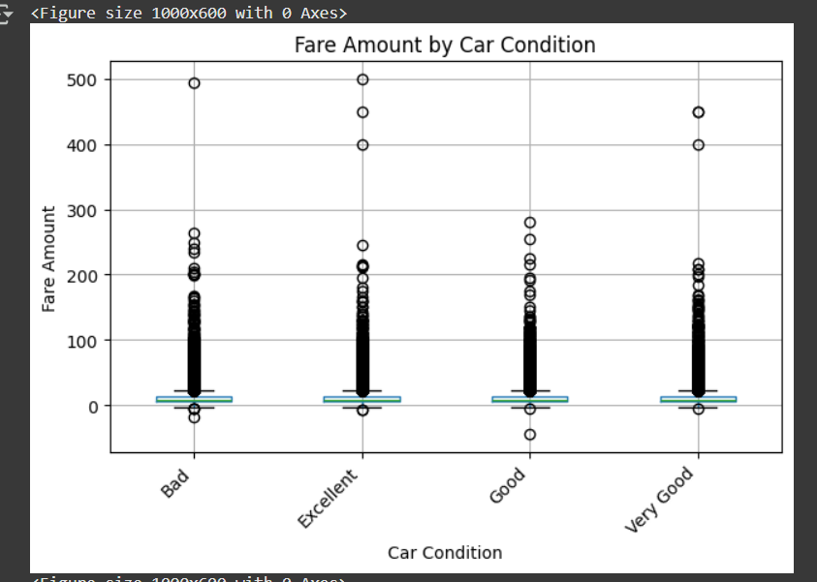
Fare Amount vs. Car Condition
"Excellent" condition cars command the highest fares, indicating passengers pay a premium for quality.
"Bad" condition cars have the lowest fares but may correlate with fewer rides (unreliable service).
"Good"vs"Very Good" shows only a marginal price difference, suggesting diminishing returns on minor upgrades.

Slide 5
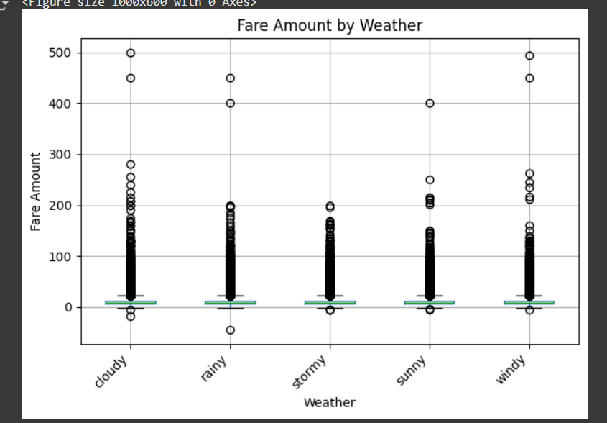
Fare Amount vs. Weather
Stormy weather has the highest fares (demand surges due to limited supply).
Sunny days show stable, mid-range pricing (normal demand).
Windy/Rainy conditions may have slight fare bumps, but less extreme than storms.

Slide 6
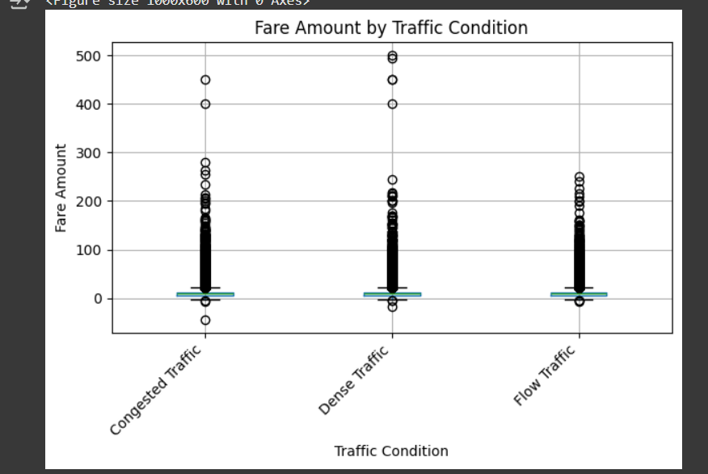
Fare Amount vs. Traffic Condition
Congested Traffic leads to higher fare amounts overall.
The median fare is slightly elevated.
There's a wider spread of values, with more high-end outliers, suggesting occasional very expensive rides.
Dense Traffic fares are moderately priced, with fewer extreme values.
Flow Traffic shows the lowest fare amounts, with a tighter distribution and minimal outliers.

Slide 7
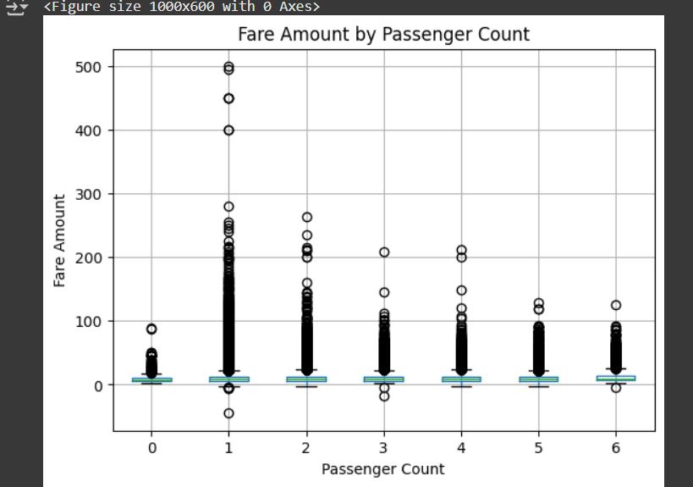
Fare Amount vs. Passenger Count
Fares are highest for single passengers (likely due to lack of cost-sharing).
Groups of 4–6 see lower average fares, suggesting discounts for shared rides.
Oddity: 6+ passengers may show a slight fare increase (possibly due to larger vehicle requirements).

Slide 8
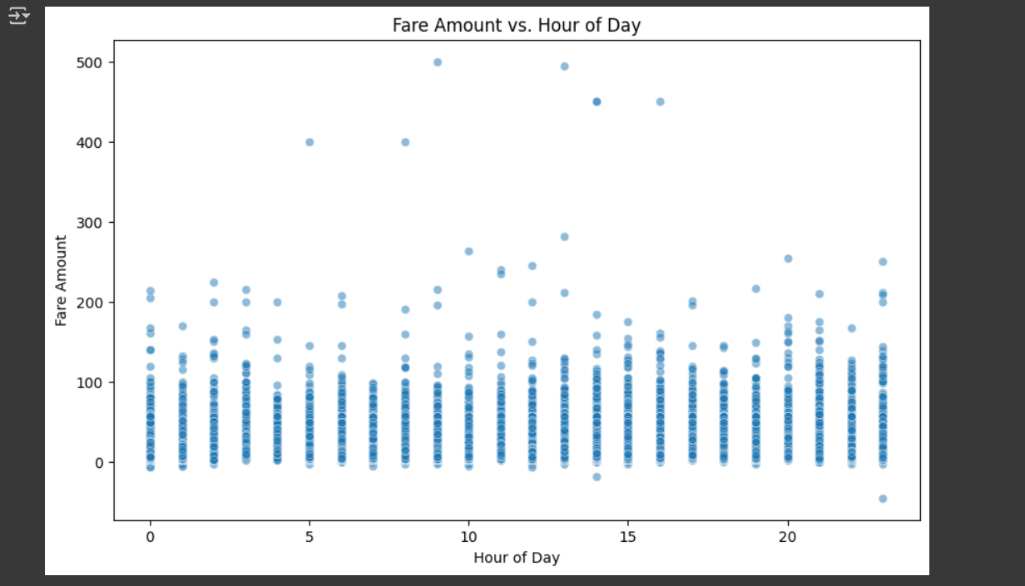
Fare Amount vs. Hour of Day
Fare amounts peak during early morning and evening hours, reflecting demand surges.
Most fares stay below 100, with occasional outliers reaching up to 500.
Time of day strongly influences fare variability and pricing dynamics.

Slide 9
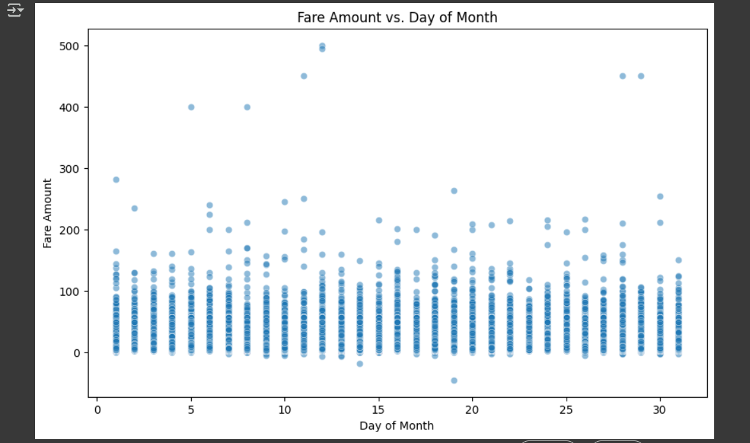
Fare Amount vs. Day of Month
Fare amounts remain mostly stable across the month, with no clear trend.
High-fare outliers appear sporadically, possibly tied to events or long trips.
Day of month alone is a weak predictor—contextual features are needed.

Slide 10
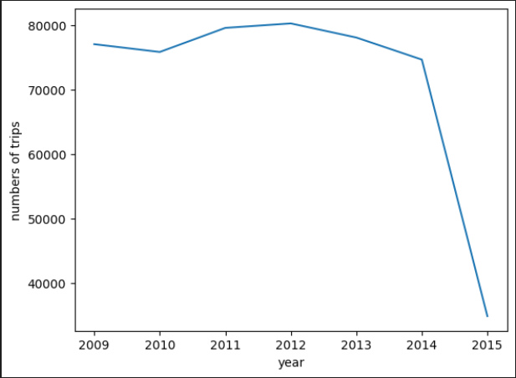
year vs. trips count
In 2015, Drob increased the number of flights.

Slide 11
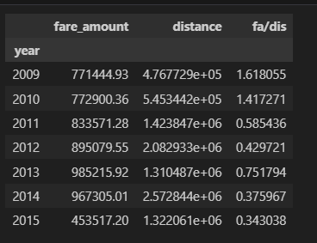
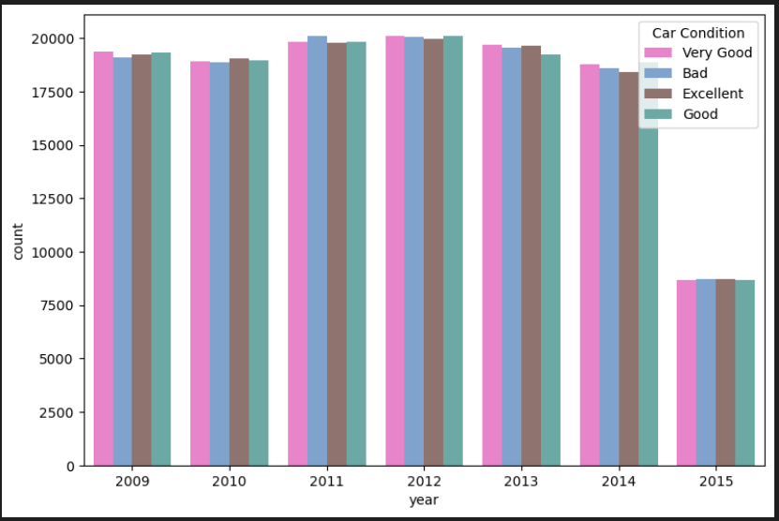
Why did the drop happen in 2015?
Here, the price per kilometer is lower in 2015. Therefore, the rise in prices is not the reason for the drop.
Here, bad service is not the reason for the reduced number of trips.

Slide 12
THANKS

